Slide 1


Analyzing Global Cyber-Attack Trends
Date: May 2025

Slide 2

Project Team:
1- Nour Ahmed Thabet 5-Karim Mohamed Kamal
2- Menna Atef Hassan 6-Mariam Mohamed Rashad
3-Akram Wael Mohamed 7-Yousef Reda Mohamed
4- Maram Amgad Mohamed
Supervised by: Alaa Abdelmoaty

Slide 3




Agenda:
Data collection and overview
Data Cleaning
Data visualization
Data Modeling

Slide 4
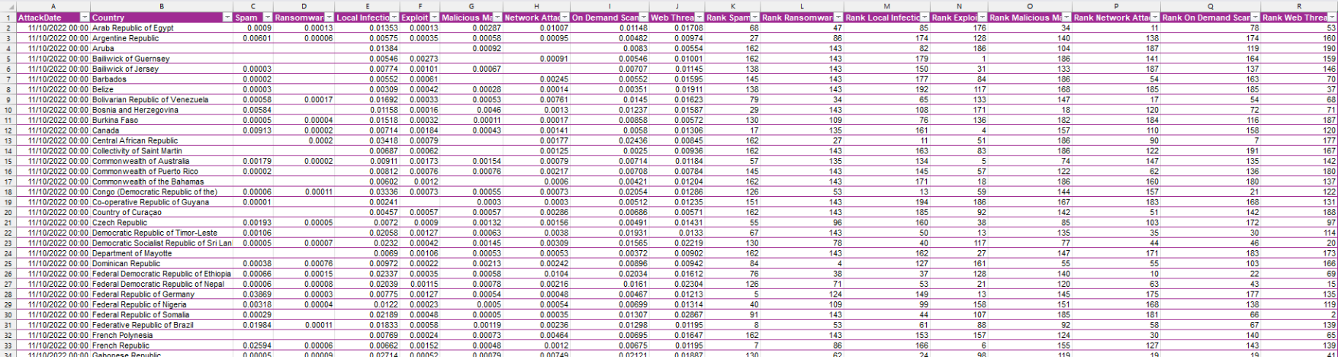
Cyber-Attack Dataset Overview
This dataset provides a comprehensive record of cyber-attacks across 225 countries over a 14-month period, from November 2022 to December 2023, with a total of 77,623 records.
The data captures the percentage share of each country and their rank affected by cyber-attacks and includes eight major attack types: Spam, Ransomware, Local Infection, Exploit, Malicious Mail, Network Attack, On-Demand Scan, and Web Threat.
This dataset enables deep analysis of global threat distribution, temporal trends, and regional vulnerabilities, supporting cybersecurity awareness and strategic planning.
Source: MIT Cyber Security Research Initiative

Slide 5
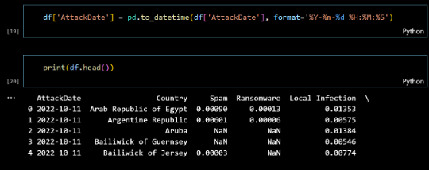
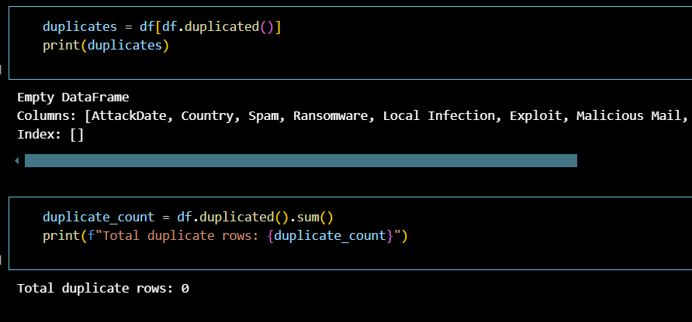
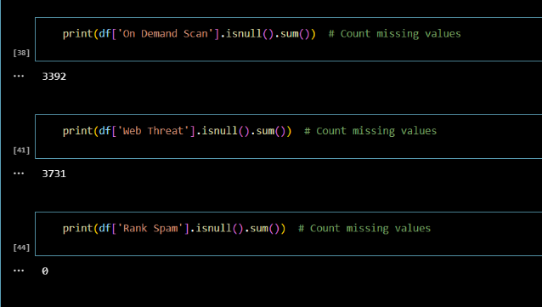
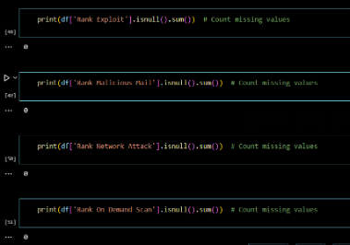
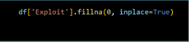
Data Cleaning & Preprocessing
1- Using Python
1-Standardized date/time formats 2-Removed duplicate records
3-Handled missing or corrupted values

Slide 6
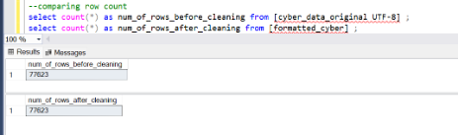
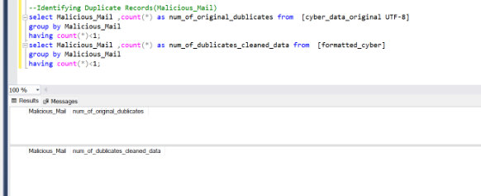
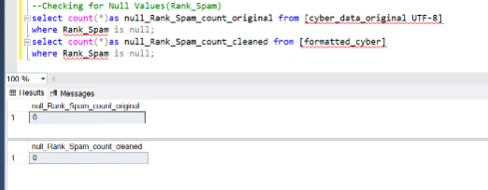
2-Using SQL Server:
1- check duplicated 2-identifiy duplicates values 3-check null values

Slide 7
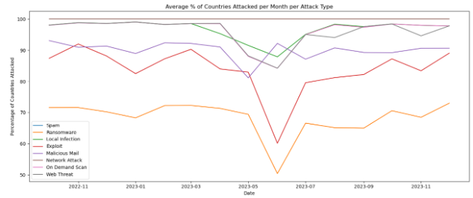
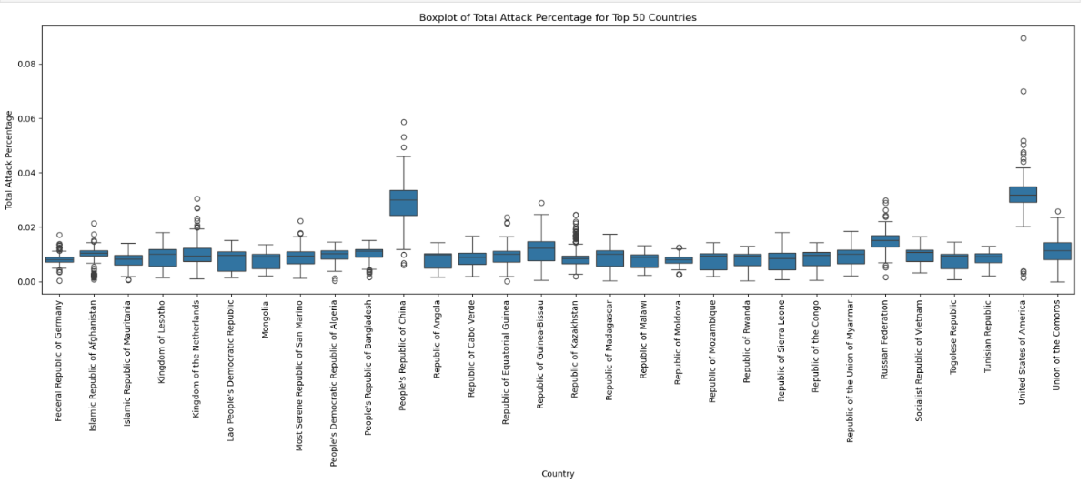
Data Patterns & Trends (with Python)
Line Chart – Attack Spread Over Time:
Shows average % of countries hit by each attack type monthly, revealing trends and seasonal patterns.
Box Plot of Top 50 Countries:
Shows attack percentage distribution in the 50 most affected countries, highlighting variation and extreme outliers.

Slide 8
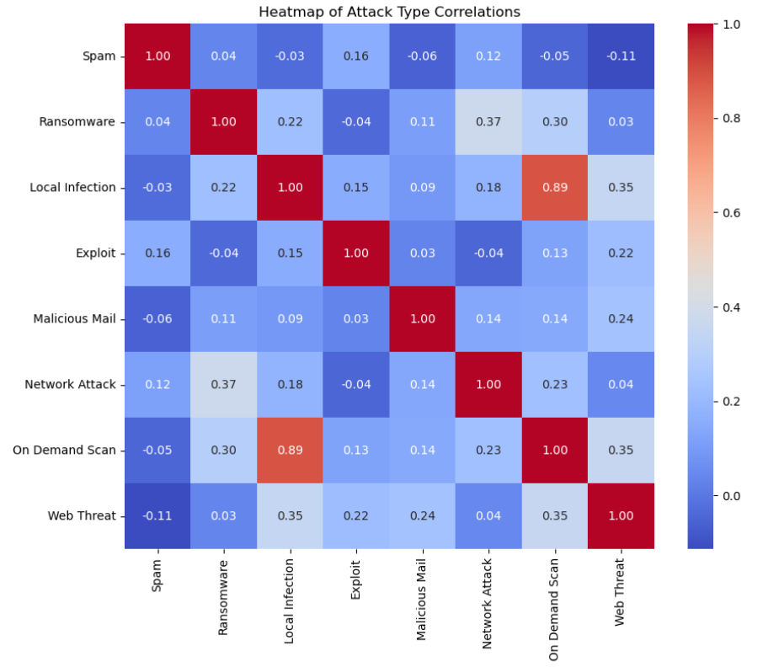
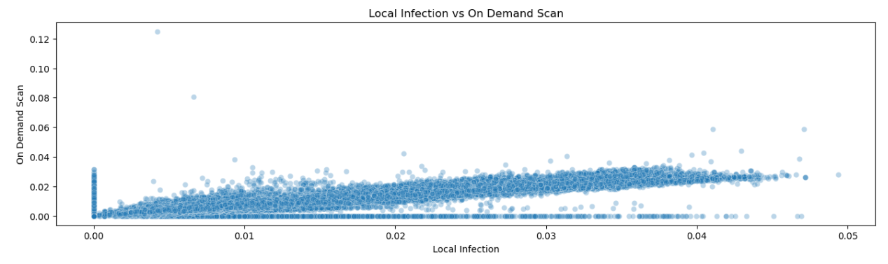
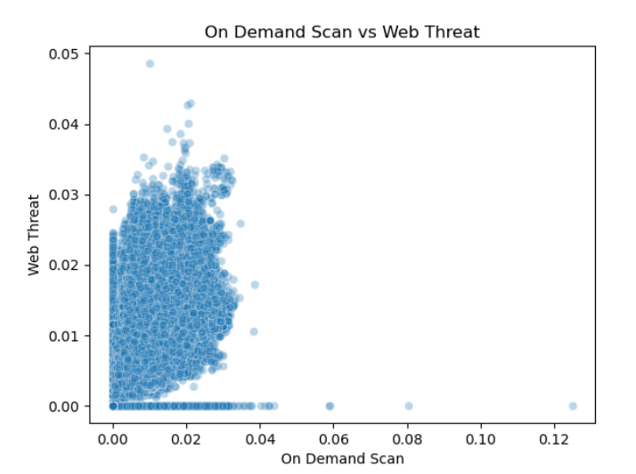
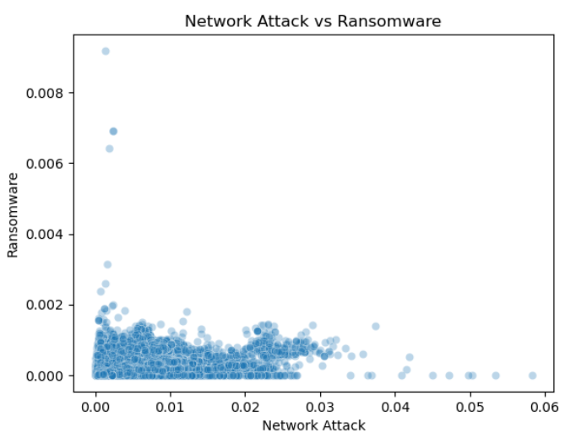
Heatmap & Scatter Plots:
Created a heatmap to explore correlations between attack types, then visualized the top 3 strongest relationships using scatter plots.

Slide 9

Dashboard

Slide 10
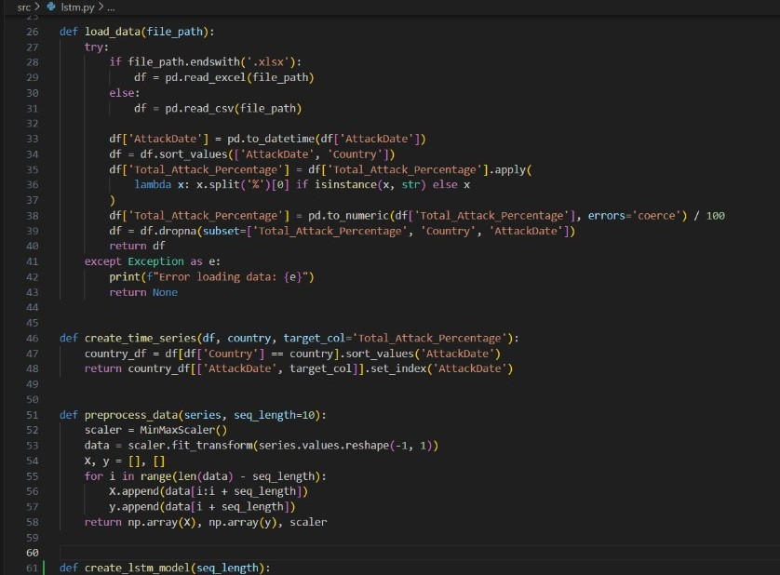
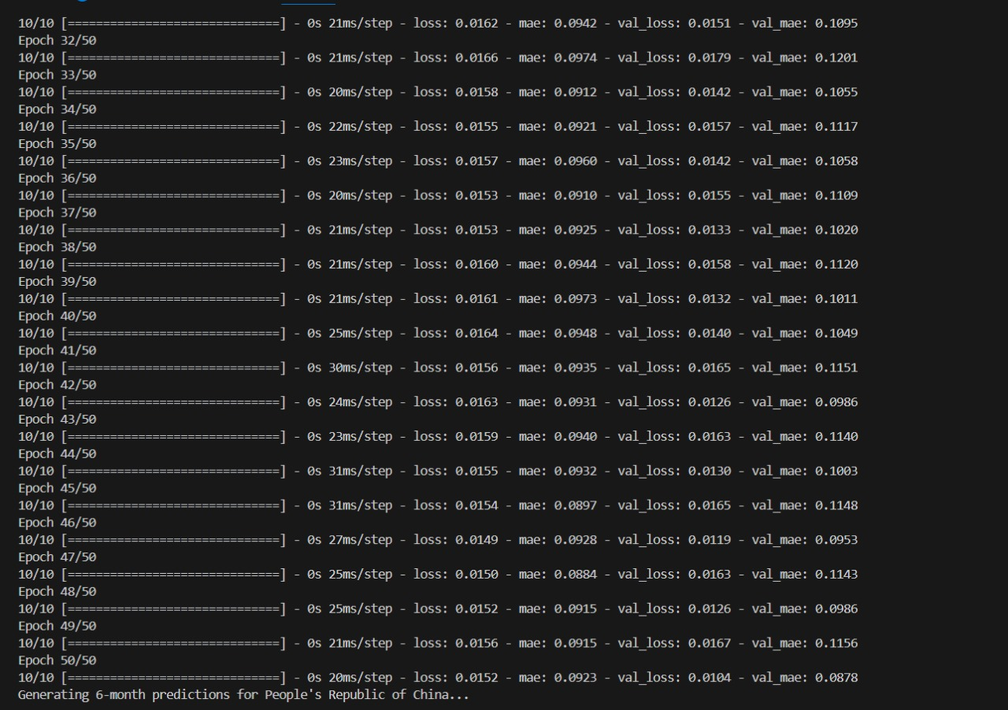
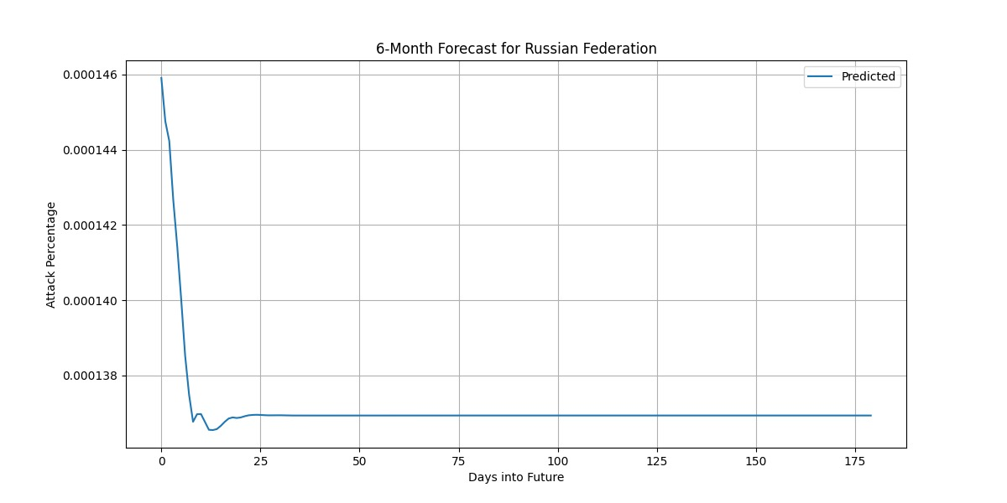
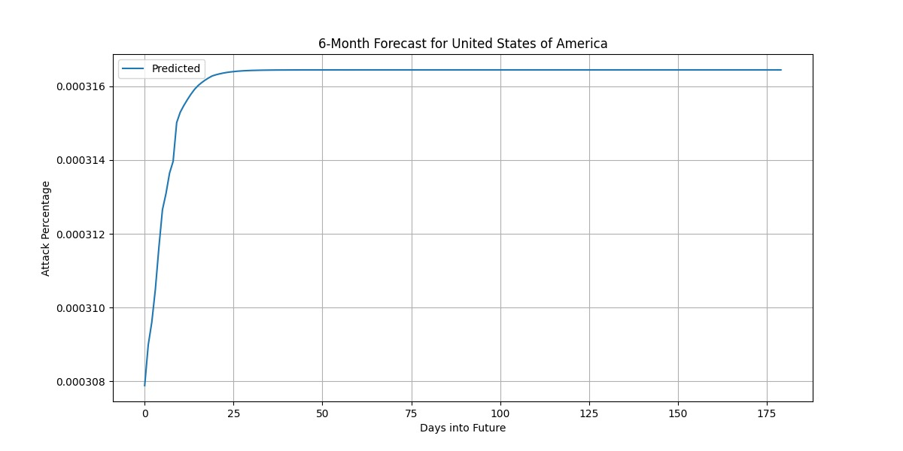
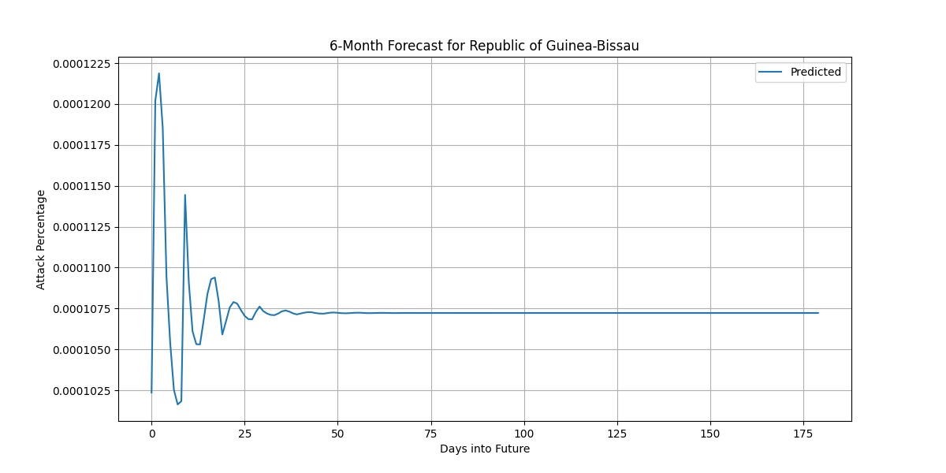
Machine Learning Model (LSTM)
This project uses a Long Short-Term Memory (LSTM) model to predict future cyberattack trends from October 2022 to December 2023. The model, trained on data from Cleanedd.Attack.csv (including the United States, China, and Afghanistan), analyzes attack percentages per country using lstm.py. It outputs predictions in future_predictions.json, forecasting attack percentage changes over 6 months. Key findings include high attack volumes in the United States and China, emerging risks in Africa, and unexpectedly high attacks in Afghanistan, possibly due to targeted campaigns. These insights help prioritize cybersecurity resources.

Slide 11
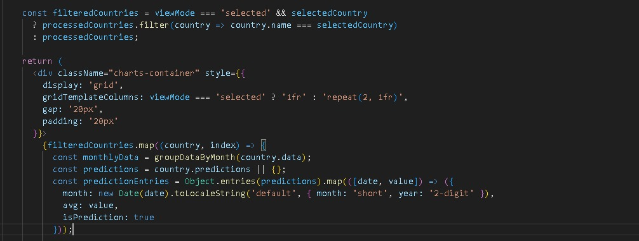
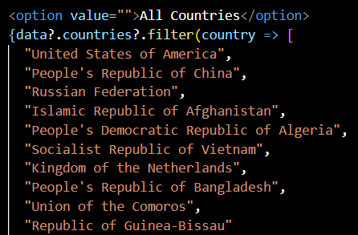
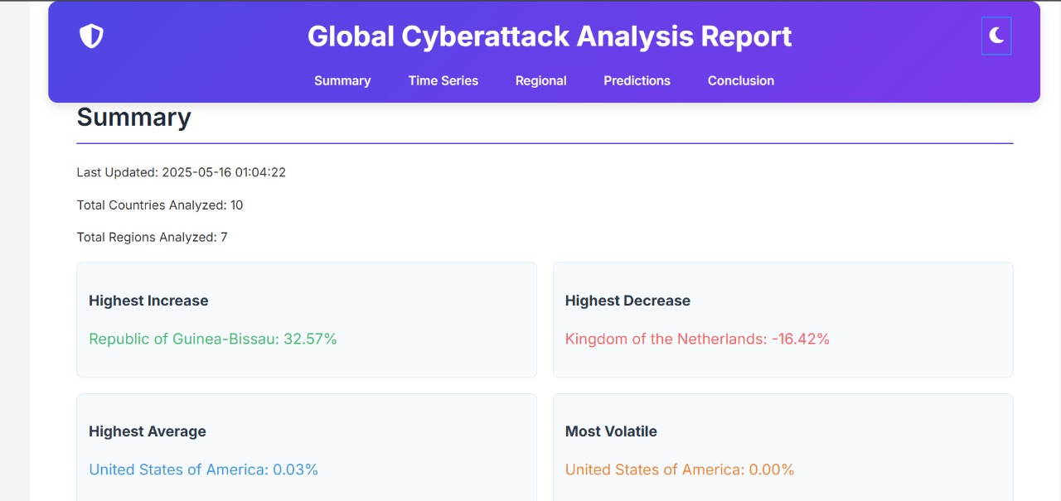
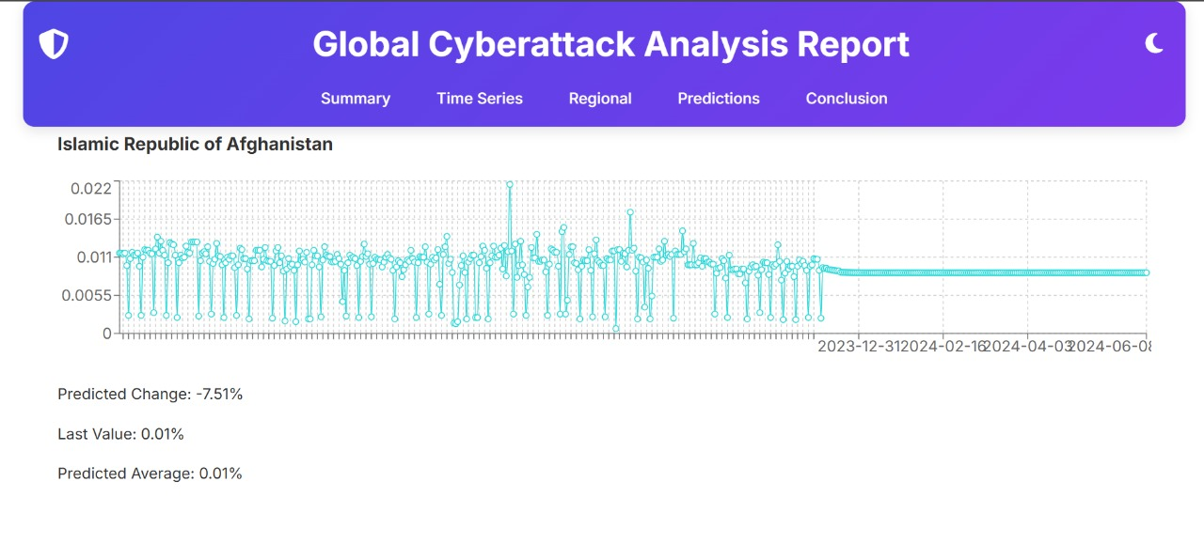
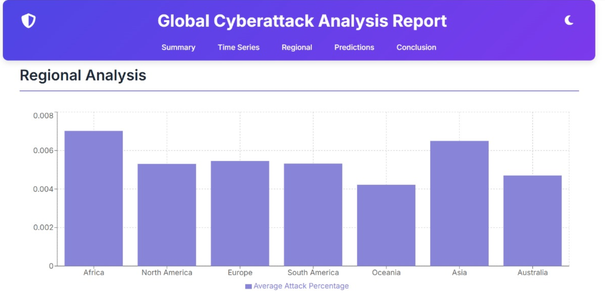
Report
Code
The Global Cyberattack Analysis Report offers key insights into cyberattack frequency and distribution. It highlights countries with the highest threat level changes, includes data visualizations, and supports interactive regional analysis. The report also features six-month forecasts and detailed information on the top 10 affected countries.
Final result

Slide 12
Thank You

